Slide 1
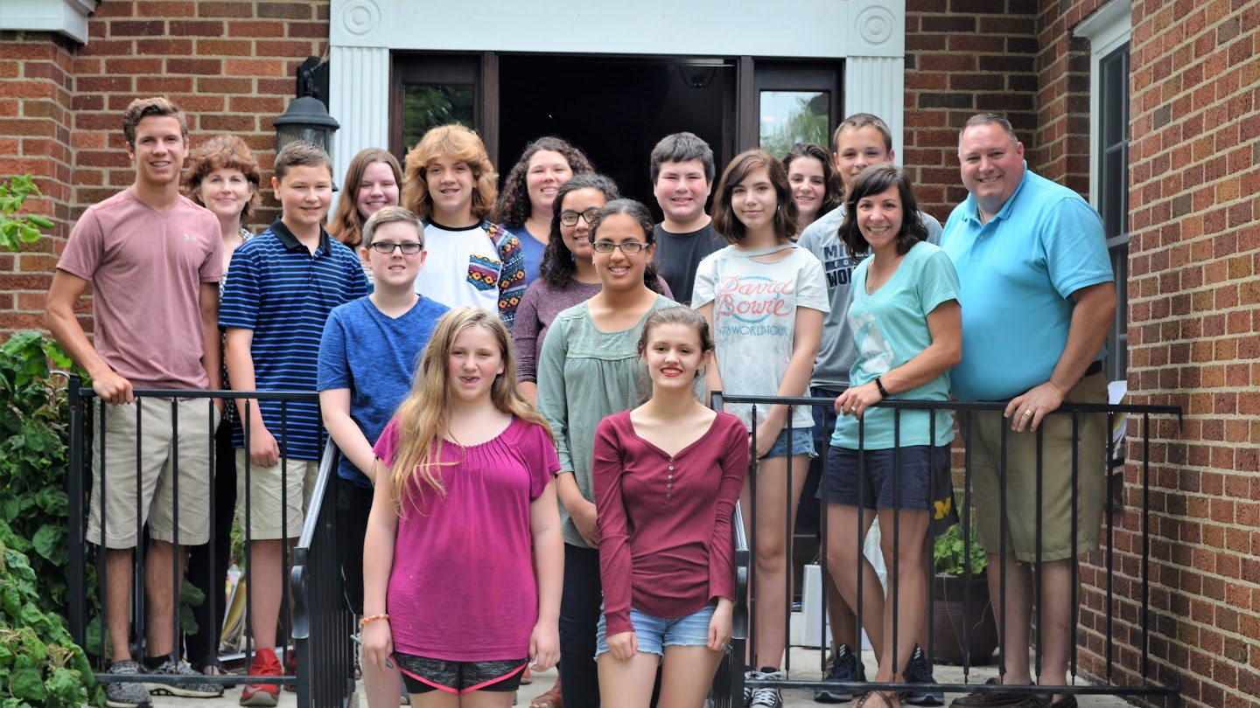
2017 Needs Assessment Survey
Mt. Pleasant Area Community Foundation’s Youth Advisory Committee (YAC)

Slide 2
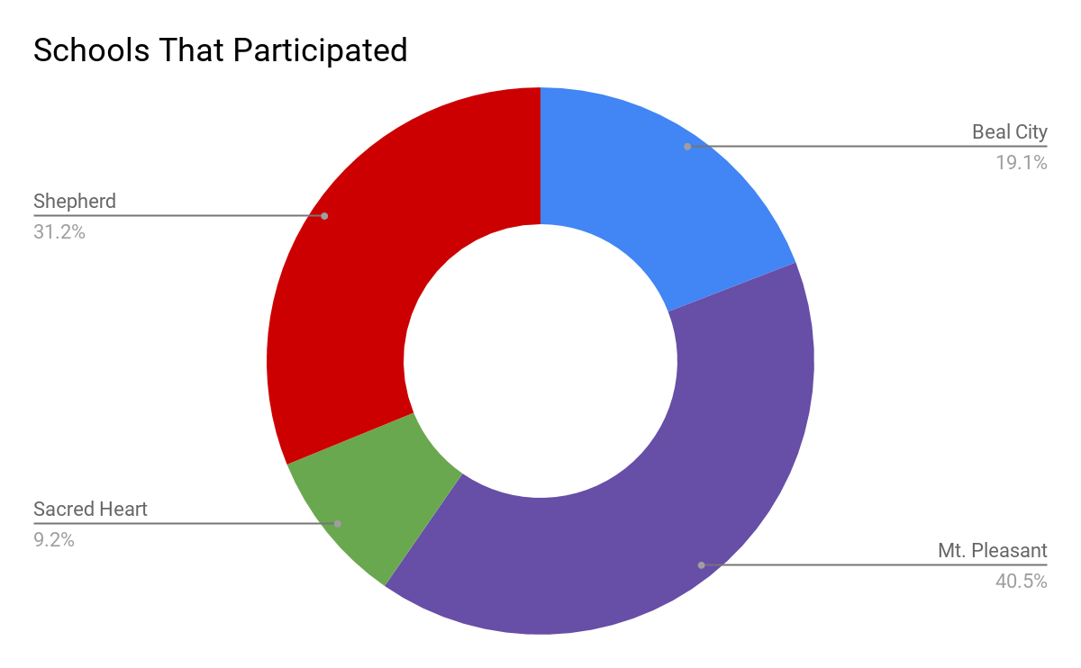
Demographics
664 Total Responses

Slide 3
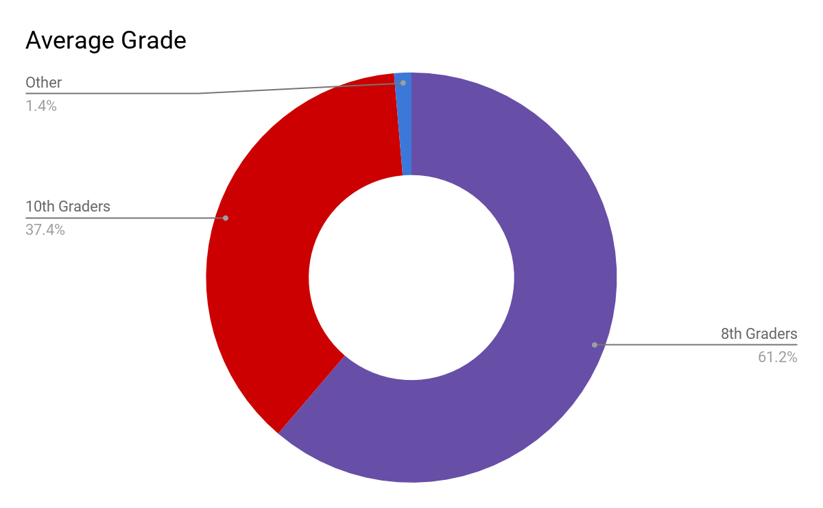
Demographics

Slide 4
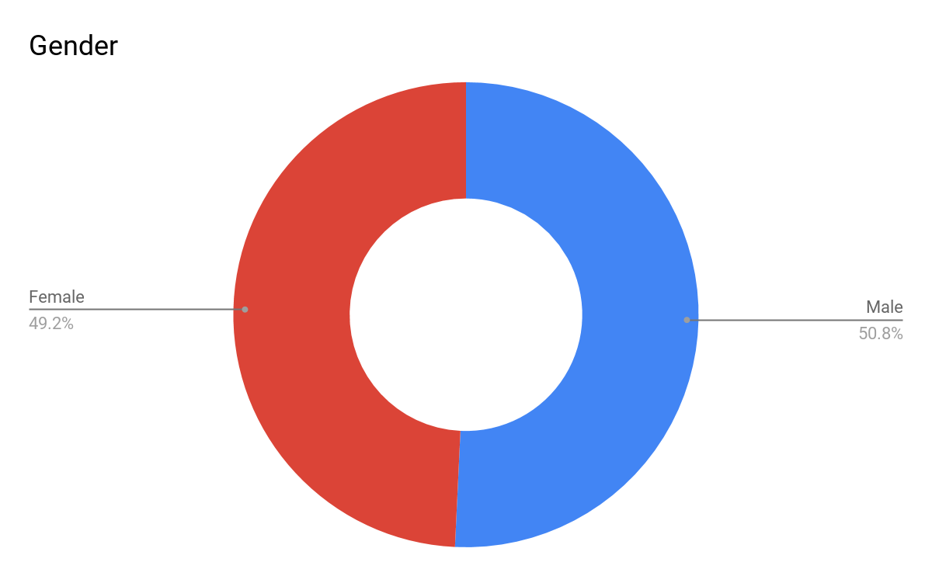
Demographics

Slide 5
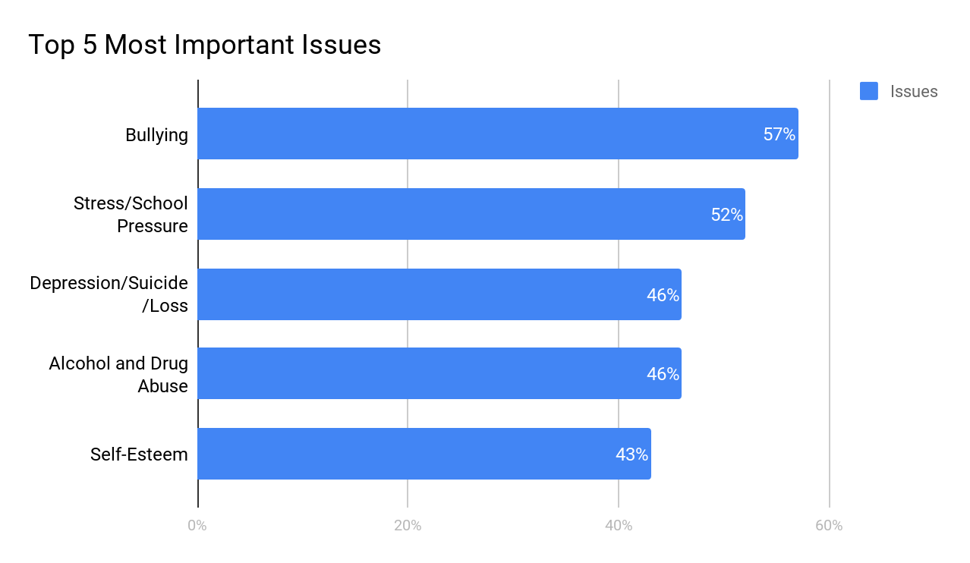
5 Most Important Issues Facing Youth Today
8th Grade Responses
Bullying
Stress/School Pressure
Depression/Suicide/Loss
Alcohol and Drug Abuse
Self-Esteem
10th Grade Responses
Stress/School Pressure
Depression/Suicide/Loss
Self-Esteem
Alcohol and Drug Abuse
Bullying

Slide 6
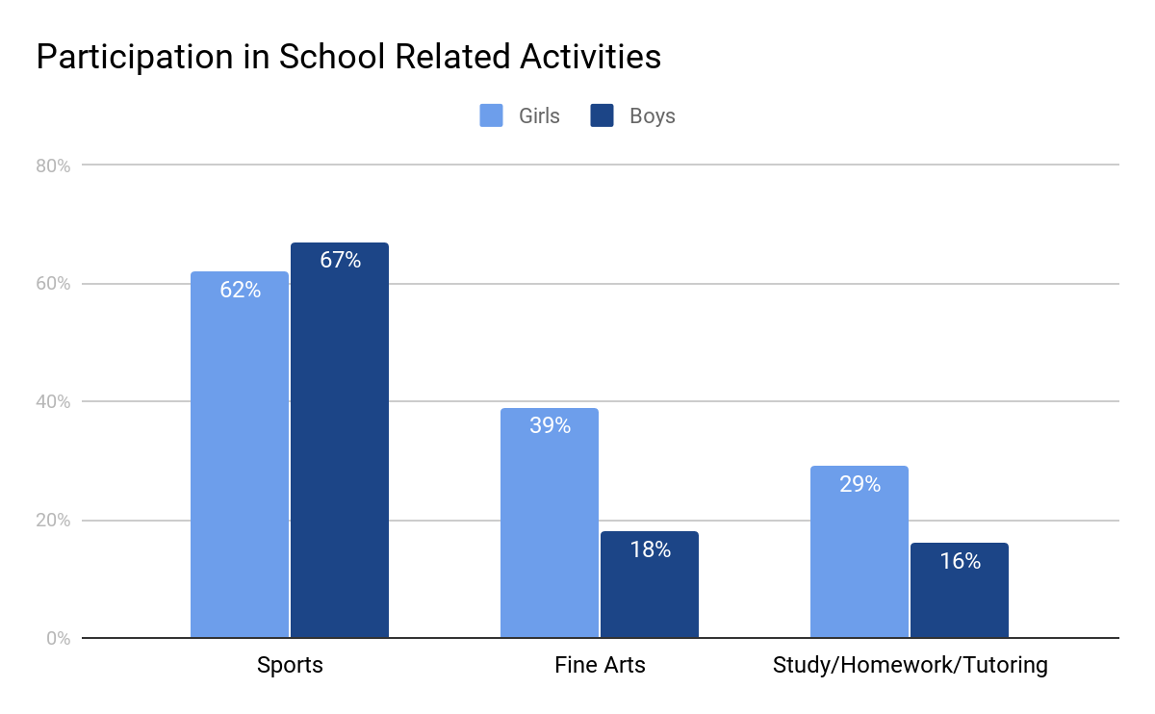
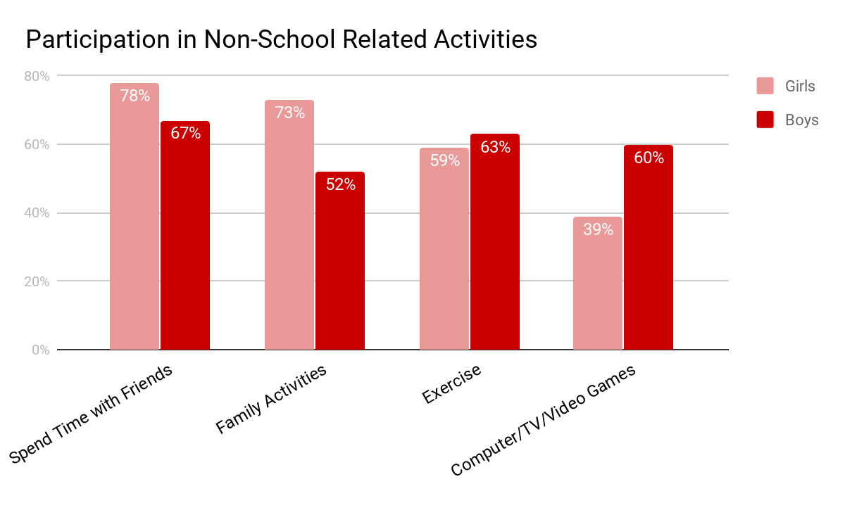
Extracurricular Activities

Slide 7
Top 5 Limits in Participation for After-school or Weekend Activities
1.
Not Enough Time
(51%)
2.
Not Interested
(44%)
3.
Family Obligations
(37%)
5.
Lack of Information
(21%)
4.
Transportation
(28%)

Slide 8
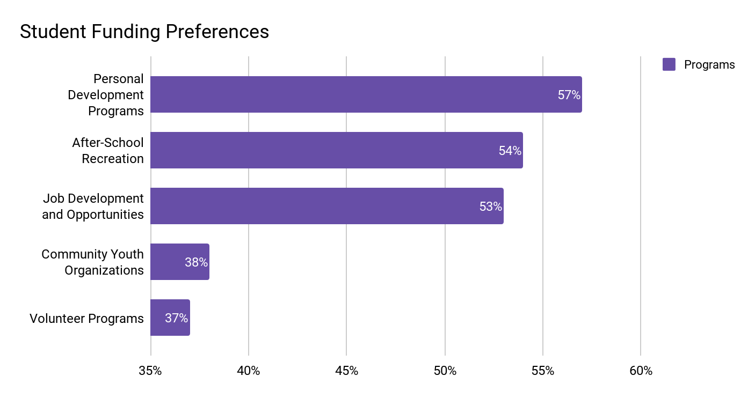
Program Areas YAC Should Fund in the Future
8th Grade Responses:
1. Leadership Activities
2. Community Youth Organizations
3. Counseling Services
10th Grade Responses:
1. Volunteer Programs
2. Leadership Activities
3. Information about Educational Opportunities

Slide 9
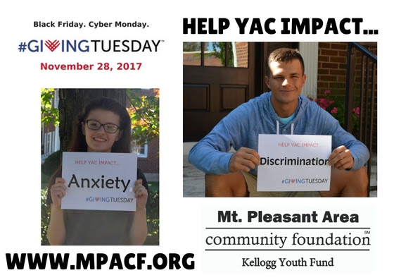
Giving Tuesday
The YAC is doing something special for the Kellogg Youth Fund in honor of our 25th anniversary! Our goal is to raise $25,000 by the end of Giving Tuesday, which is November 28th this year.
Check out our Facebook page to learn more about #GivingTuesday, or visit the website below to donate now!
www.mpacf.org

Slide 10
Mini Grant Opportunities
Mini‐grants up to $300 are available through the MPACF, anytime of the year!
The YAC awards approximately $30,000 each year from the Kellogg Youth Fund, including multiple mini-grants.
Mini‐grant applications are accepted year round. Review and approval takes 60‐90 days, so plan to apply well in advance to secure funding.
Visit www.mpacf.org to learn more!

Slide 11
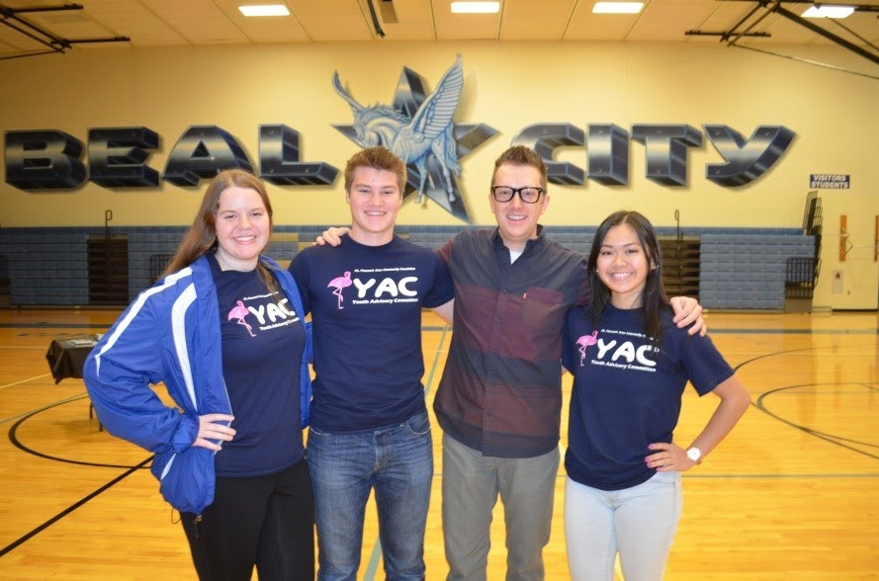
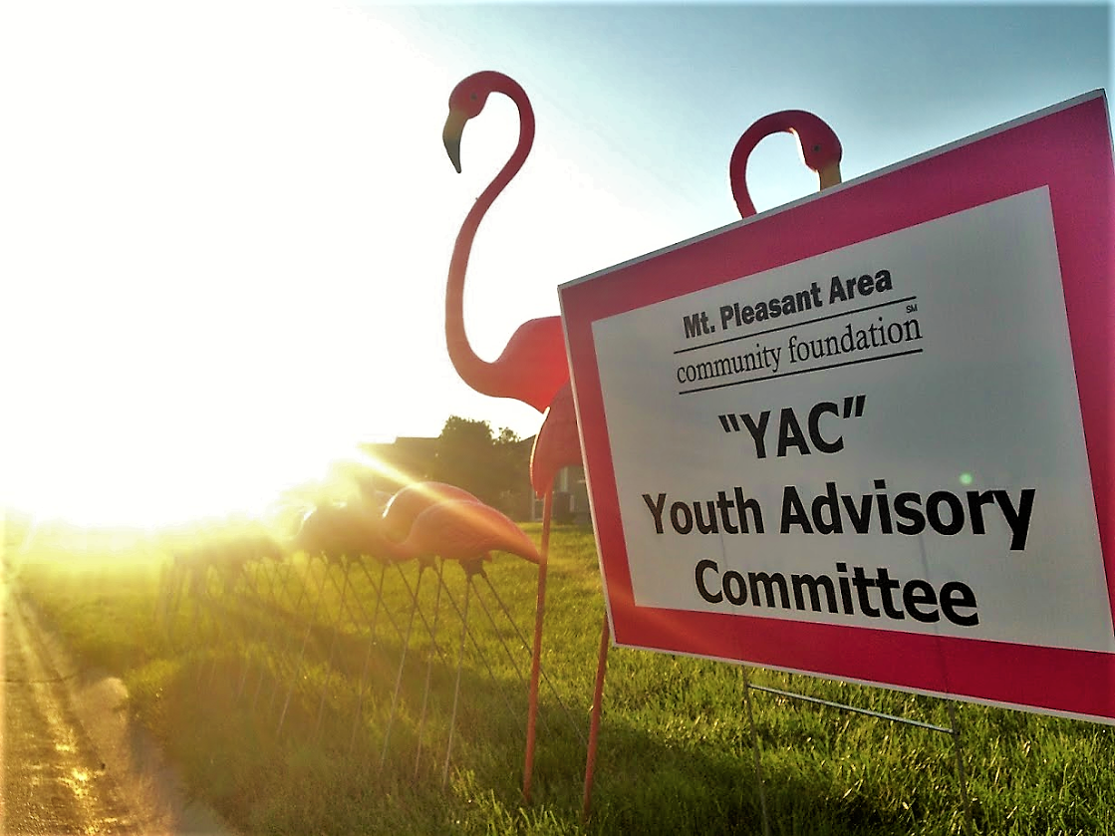
Contact YAC
Mt. Pleasant Area Community Foundation
989-773-7322
www.mpacf.org/yac

